Slide 1
AI IMPLICATIONS ON DEVELOPING COUNTRIES
Notes:
The presentation will be divided into two main sections;
The first section will highlight a study on how AI/robots (used interchangeably) could widen the development gap between Rich and Poor nations
The second section will discuss ways developing countries can harness the power of AI and technology

Slide 2
How AI Advancement Widens The Rich Nation - Poor Nation Gap
New AI technologies widen the gap between rich and poor countries by shifting investments to already developed countries.
This in turn negatively affects the jobs in developing countries by essentially replacing them
Why ?
Notes:
Basically, with the development of new AI technologies disproportionately between rich and poor countries, more investments would be shifted towards advanced countries where these technologies make automation faster
Since developing countries heavily rely on their labour force, investments would be more directed towards countries that already have the existing automation facilities and in effect negatively affecting the livelihoods of people in these countries
Before looking at the study, why do you think this might be the case ? (cost, quality, laboretc?)
I will now talk about the study, which tried to model the effects of the advancement of robots on developing countries

Slide 3
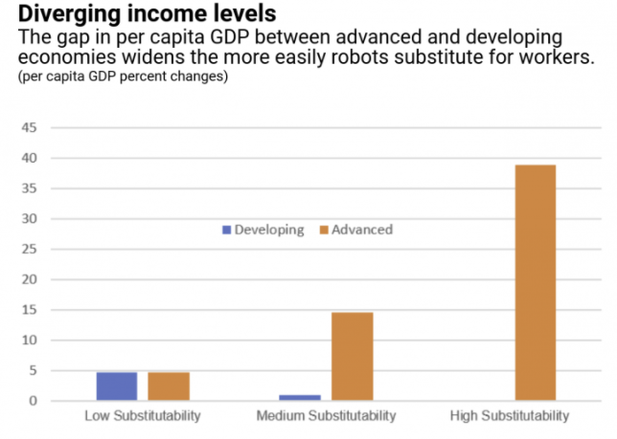
Impact Study
Notes:
Analysts from the IMF (International Monetary Fund) conducted a study to find out how the different levels of technological development affects economic growth.
They modeled the two countries one representing a developing country, and the other a developed first world country. They based the study mainly on the labor, capital and robots or technological advancement of the two countries
They found that, the more advanced the country was, which was measured by the degree of substitutability between robots and human labor, the larger the gap.
Why this was the case was because, generally, the economic sector of developing countries rely more on unskilled labor compared to developed countries.
What does this mean?

Slide 4
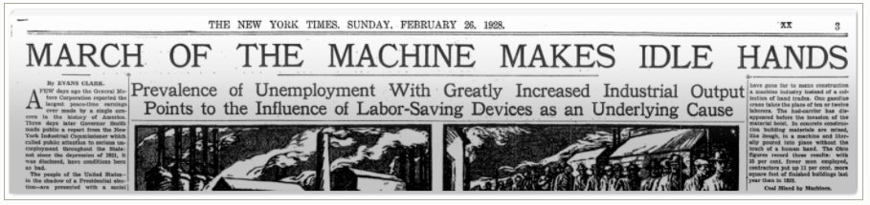
Notes:
Newspaper from 1928 talking about the effects of robots, really interesting

Slide 5
Implications - By The Numbers
Developing countries have higher numbers of semi and unskilled labor which are easily replaceable
Examples: driving, farming, woodwork
By the end of 2022, over 20 million jobs will be replaced by technology
By 2035 - 2040, the number will be approaching close to a billion
Notes:
Since most developing countries rely on semi and non-skilled labor, automation would have the most drastic effects.
The activities carried out such as driving, woodwork and agriculture are easily replaceable by robots. Example: in my country, there are about 1 - 1.5 million transportation workers including taxi and bus drivers would would completely be eliminated if self driving cars become pervasive
By 2040 about a billion jobs would be lost ie about 1 in 5 jobs around the world

Slide 6
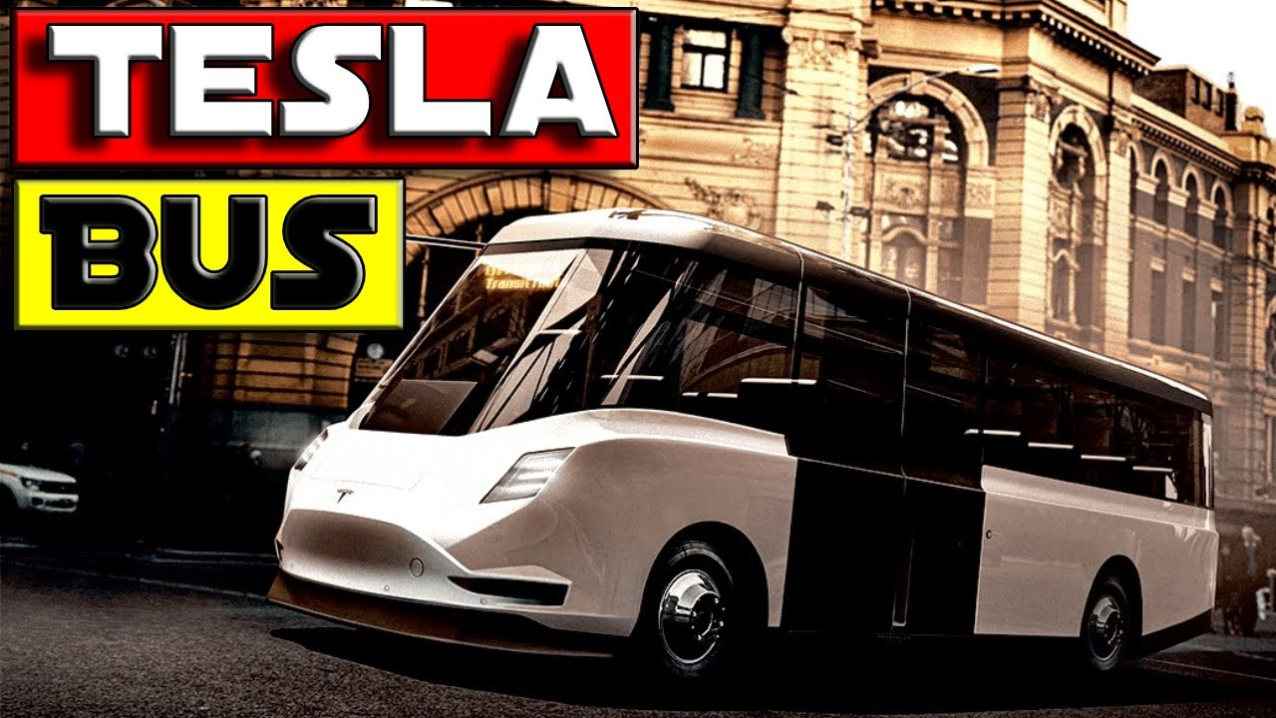

Slide 7
Questions
3
1
5
Is automation a good thing ?
What are the main causes, in your opinion of this disproportionate levels of automation in different countries ?
General thoughts or additions
2
4
As a leader of a developing country what would you do differently?
What should developed countries do differently?
Notes:
Is automation a good thing ? considering the number of jobs that would be lost ?
As a leader of a developing country what would you do differently?
What are the main causes, in your opinion of this disproportionate levels of automation in different countries ?

Slide 8
THANK YOU!

Slide 9
References
https://www.cgdev.org/publication/automation-and-ai-implications-african-development-prospects
https://ideas.repec.org/a/for/ijafaa/y2018i49p18-27.html
https://www.un.org/press/en/2019/gaef3523.doc.htm
https://blogs.imf.org/2020/12/02/how-artificial-intelligence-could-widen-the-gap-between-rich-and-poor-nations/

